Slide 1
ADAPTING AGILE Servant Leadership Change Management Scrum Values & Pillars

Slide 2
Servant Leadership
Robert Greenleaf coined the phrase servant leadership in the 1970s which focuses on service to others
Servant Leaders:
Put others before themselves
Help to change things for the better
Try to understand others
Try to see the best in everyone
Listen
Include everyone
Try to create a community
Engages by leading with questions, which they feel are of more important than providing answers
Focuses on shifting from managing for results to designing environments that create results
Role model collaboration and accountability

Slide 3
ROBERT GREENLEAF’S TEN CHARACTERISTICS OF A SERVANT LEADER
Empathy
Listening
Conceptualization
Healing
Awareness
Persuasion
Stewardship
Foresight
Building Community
Commitment to Growing People

Slide 4
Change Management

Slide 5
Goal of Change Management
Source: On Death and Dying by Dr Elisabeth Kübler-Ross. Copyright © 1969 by Elisabeth Kübler-Ross; copyright renewed © 1997 by Elisabeth Kübler-Ross. All rights reserved.

Slide 6
Agile and Waterfall – Change Impact on Staff
Consider the table below comparing some key characteristics of Agile and Waterfall.
As a Team, discuss and identity from a change management lense, how a transition to agile from waterfall might make people feel in the following roles:
Project Manager, Business Analyst (writes requirements) QA (testers), Staff Managers)
CHARACTERISTIC | AGILE | WATERFALL
Development Approach | Cyclical, Iterative, Incremental | Sequential and Singular
Development Definition | Customer Orientated with Team Members Collaborating Constantly | Task Driven, Individuals Focusing on Their Tasks Primarily
Requirement Definition | High Level Requirements Defined with More Detail Expected Nearer When Work Begins, Change Welcomed | Full Definition Defined at the Beginning of the Project, Minimal Change Expected
Customer Engagement | Continuous | Mainly at the Beginning and End of the Project
Management | Supporting Team Focus on Customer, and Their Own Capabilities and Culture | Focus on Team Members Executing Toward Plan
Tactical Leader | Agile Team Itself | Project Manager
Primary Measurement | Incremental Working Software for the Customer, Understanding the Customers Evolving Needs | Lines of code, Time Spent, Reported Percent Complete, Number of Defects Closed, Completeness of Project Requirements

Slide 7
Engagement

Slide 8
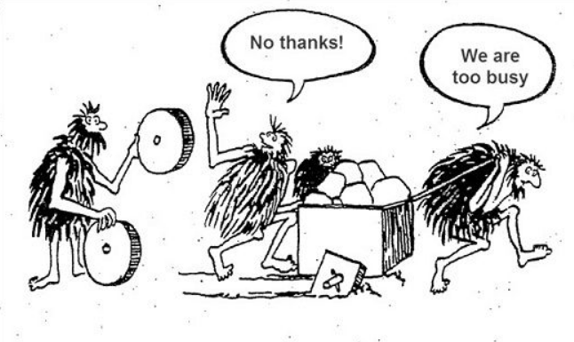

Remember our friends with the cart?
They need…
A. To know about the wheels
D. To want the wheels
K. To know how the wheels work
A. To use the wheels
R. Lasting change through reinforcement
More info at https://www.prosci.com/adkar/adkar-model

Slide 9
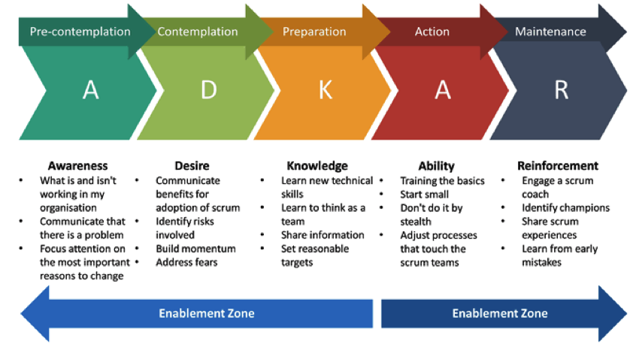
Agile and Waterfall – Change Impact on Staff
Select ONE Role (Project Manager, Business Analyst (writes requirements) QA (testers), Staff Managers)
from the Prior Exercise Who Your Team Has Identified as Someone Who May Have a Challenging Time with the Change from Waterfall to Agile.
Using the ADKAR Method, Outline Steps You Might Try and Work with that Individual to help Minimize Their Own Change Management Curve

Slide 10
SCRUM SUPPORTS HEALTHY TEAM CULTURE

Slide 11
SCRUM VALUES AND PILLARS
TRANSPARENCY
INSPECTION
ADAPTION
The emergent process and work must be visible to those performing the work as well as those receiving the work.
Agreed goals must be inspected frequently and diligently to detect potentially undesirable variances or problems
If any aspects of a process deviate outside acceptable limits or if the resulting product is unacceptable, the process being applied or the materials being produced must be adjusted.
SOURCE: SCRUM.ORG & SCRUM GUIDE

Slide 12
How Might the Scrum Values and Pillars Help Prevent “Unethical” Actions from Occurring within an Organization (identify at least 3 values or Pillars and their actions)?
TRANSPARENCY
INSPECTION
ADAPTION
The emergent process and work must be visible to those performing the work as well as those receiving the work.
Agreed goals must be inspected frequently and diligently to detect potentially undesirable variances or problems
If any aspects of a process deviate outside acceptable limits or if the resulting product is unacceptable, the process being applied or the materials being produced must be adjusted.
SOURCE: SCRUM.ORG & SCRUM GUIDE

Slide 13
NEXT CLASS - MIDTERM
2 Parts
Multiple Choice & True/False
50% of Grade
15-20 questions
Written Response
50% of Grade
2-3 Responses
Possibly Project Charter
Possibly 2-3 Paragraph response
Possibly Identify and Describe if Given a Scenario
Covering All Material Taught to Date
Slides, Readings, Assignments
Open Book
Can only reference sources from Slides, Readings, Assignments
Full Class Time Allotted for the Exam

